Slide 1
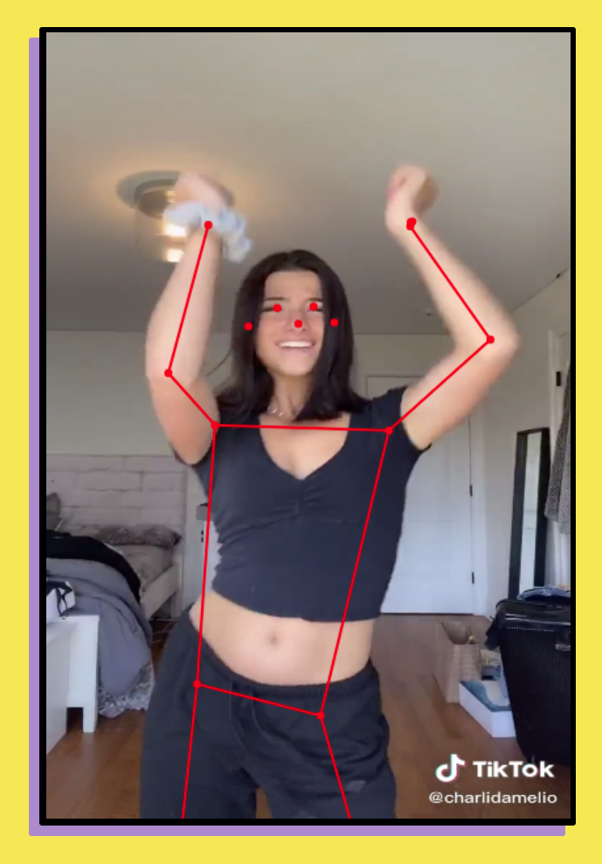
PoseDance: A TikTok Trainer
Jen Looper
@jenlooper
Cloud Advocate Lead, Microsoft

Slide 2
agenda
What is TikTok?
What is PoseNet?
Digging Deeper
Building PoseDance
Let's dance!

Slide 3

What is TikTok?
THE GREATEST MOBILE APP
Musical.ly’s evolution
A total time-waster but very fun! Like Vine – short videos
Famous for dances!
https://www.rollingstone.com/culture/culture-features/i-spent-a-week-on-tiktok-811361/

Slide 4
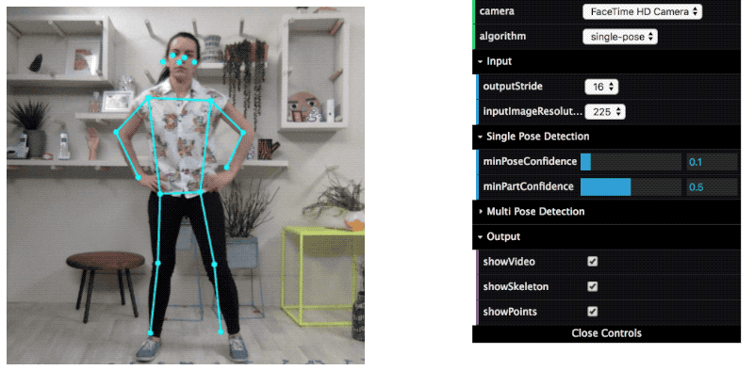
What is PoseNet?
Pose detection in the browser
Uses TensorFlow.js – so can be used on web
Can be used with webcam, video within canvas, or still pics
Can display one or more persons
Being used for sports
PoseNet just gives estimations of position of 17 key body points – you have to create the skeleton on canvas

Slide 5
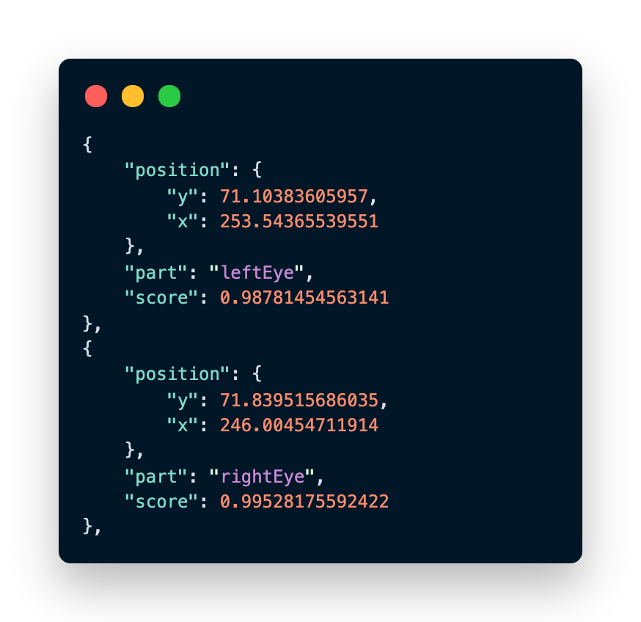
Example output

Slide 6
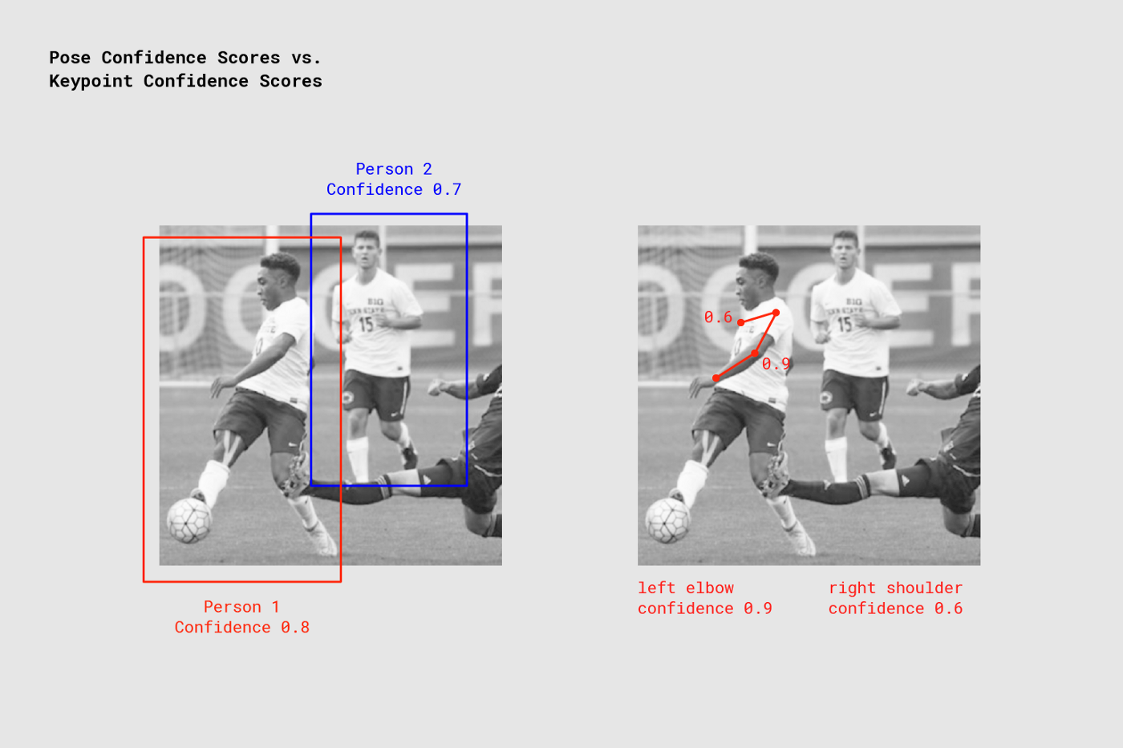
Digging deeper
What’s going on under the hood? PoseNet is built on top of ‘PersonLab’ models.
PersonLab is a new way of determining people’s stances and actions in a video or photo
Previous: “top down” (person first) determination using bounding boxes
New: “bottom up” (parts first) box-free fully convolutional determination predicting relative position of 17 keypoints (eye to eye, shoulder to shoulder).
Starts from the most confident detection and works up based on trained body poses
Research Paper: https://arxiv.org/pdf/1803.08225.pdf

Slide 7
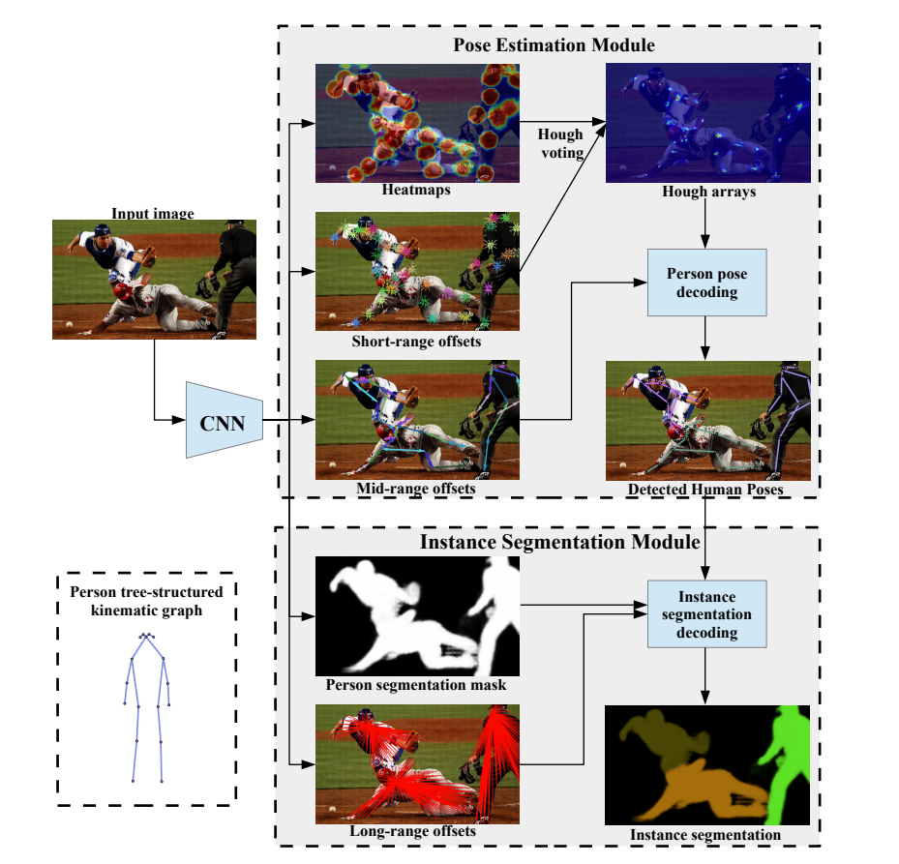

Digging deeper
“Hough transform is a feature extraction technique used in image analysis, computer vision. It’s designed to find imperfect instances of objects within a certain class of shapes by a voting procedure”. Invented in 1959!
Use CNN to build heatmap and short-range offset predictions for keypoints, and ‘vote’ (Hough Voting) on best ones
Use CNN to build mid-range offsets between body parts
Detect all human poses
Decode each instance of a person, determining long-range offsets to build person mask
Research Paper: https://arxiv.org/pdf/1803.08225.pdf

Slide 8
PersonLab -> PoseNet
Project of Google Creative Lab
Run realtime pose estimation in the browser
Abstracted away complexities of model
Encapsulated functionality into easy to use methods
Installable via npm as part of tensorflow-models
Accompanies tensorflow.js – use TF models in your browser
Uses ‘fast greedy decoding’ algorithm from PersonLab paper
https://medium.com/tensorflow/real-time-human-pose-estimation-in-the-browser-with-tensorflow-js-7dd0bc881cd5

Slide 9
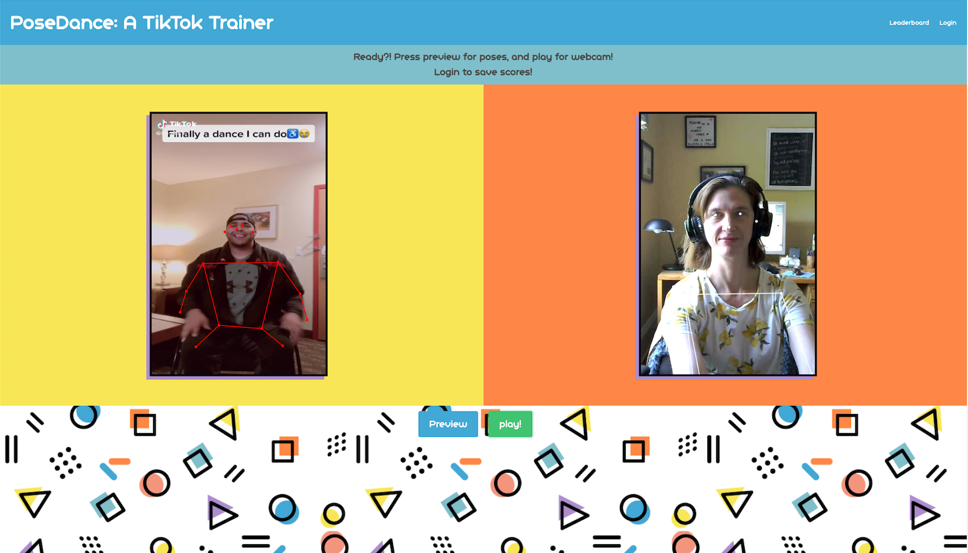
Let’s build an app!
Use PoseNet to compare a dancer’s movement to your own, comparing TikTok video to your webcam output!

Slide 10
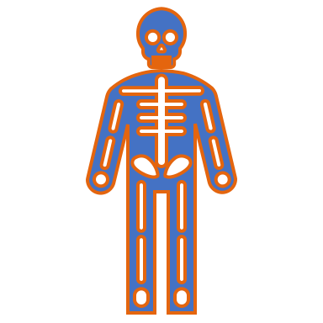
Hold up
Are PersonLab, PoseNet or PoseDance inherently ableist?
It doesn’t make judgements, it just measures
HOWEVER
Creating an app on top of TikTok comparing your moves via scoring to semi-pro abled dancers MIGHT be ableist
Let’s make sure to make this inclusive

Slide 11
Building PoseDance
Design considerations
Base architecture
Using PoseNet
Handling webcams and heavy loading models
Building Scoring/Leaderboard
Backend implementation
Azure functions
Playfab
Deployment

Slide 12
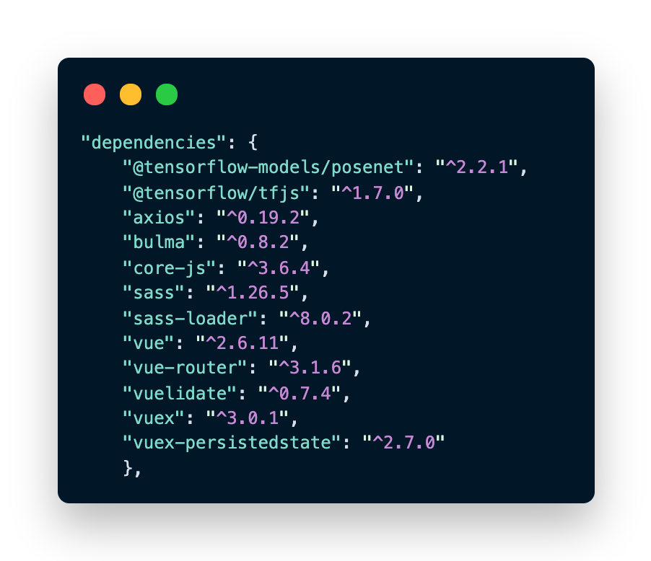
Design/Architecture
Vue.js
Bulma with SASS for styling
Vuelidate to validate auth form fields
Vuex to save user state
Axios to make calls to API
Tensorflow.js and Tensorflow’s PoseNet model

Slide 13
Using TikTok + WebCam
Side-by-side layout analyzing TikTok .mp4 with WebCam output
Can’t use TikTok embedded code with PoseNet, must attach mp4 to canvas to draw keypoints/skeleton
Ensure preview and attribution of video by showing original then exported video

Slide 14
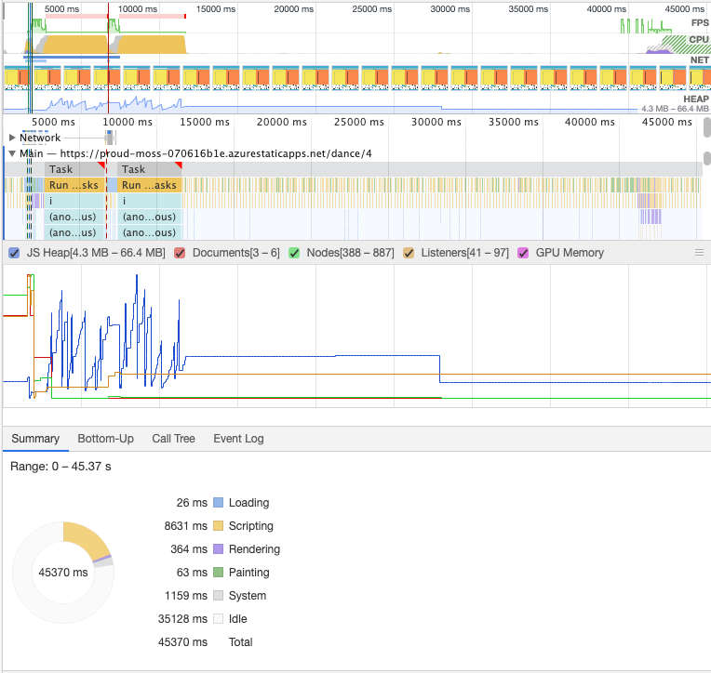
Using PoseNet
Finally finishes loading model, video and webcam
Big models! And load up 2, 1 per cam
Make sure to wait for .mp4 to load
Ensure that webcam is ready if wanted (allow for preview mode)
Encourage login to save scores
Have a loader widget run
🤯

Slide 15
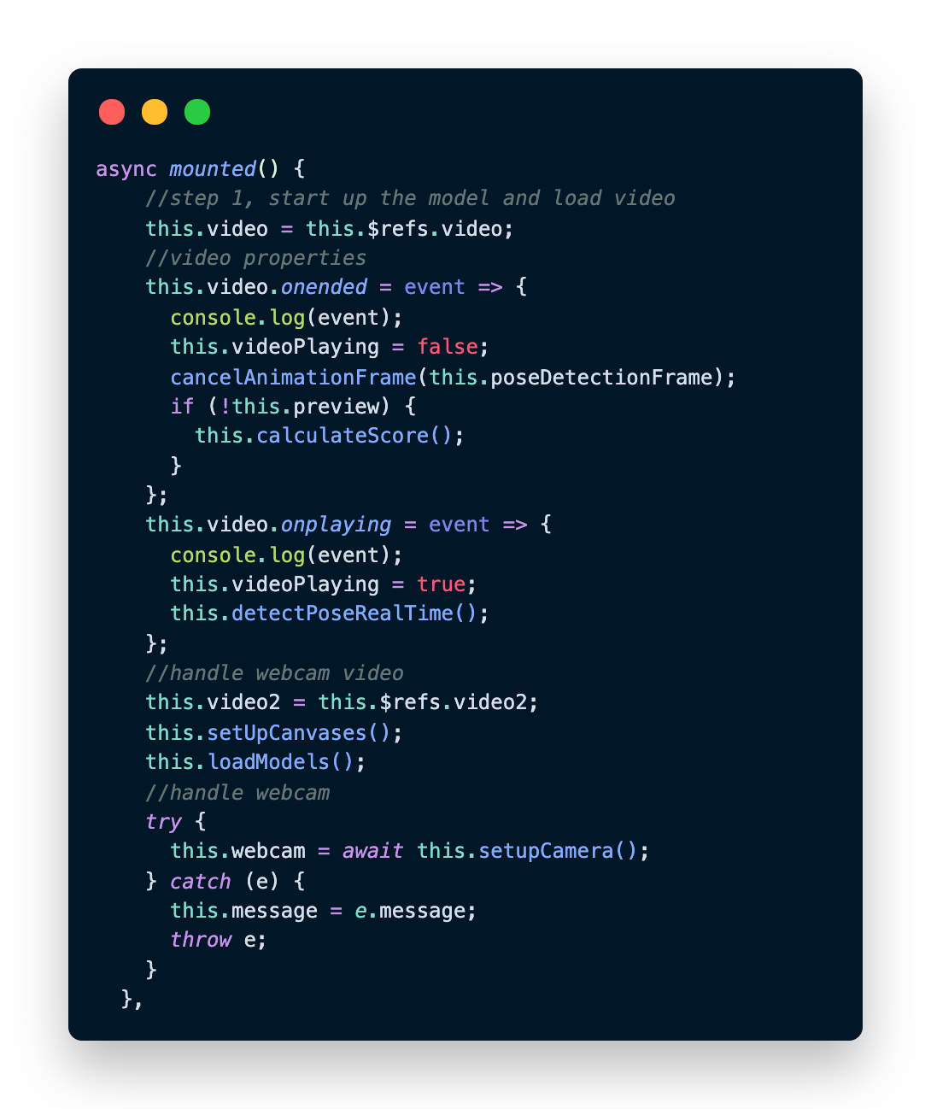
Video/WebCam
Async is your friend
Reference the TikTok video
Setup, enable and reference the WebCam video
Setup 2 canvases to draw keypoints/skeletons
Load up the models
Handle video events
Detect poses when it’s playing
Calculate score when it’s done

Slide 16
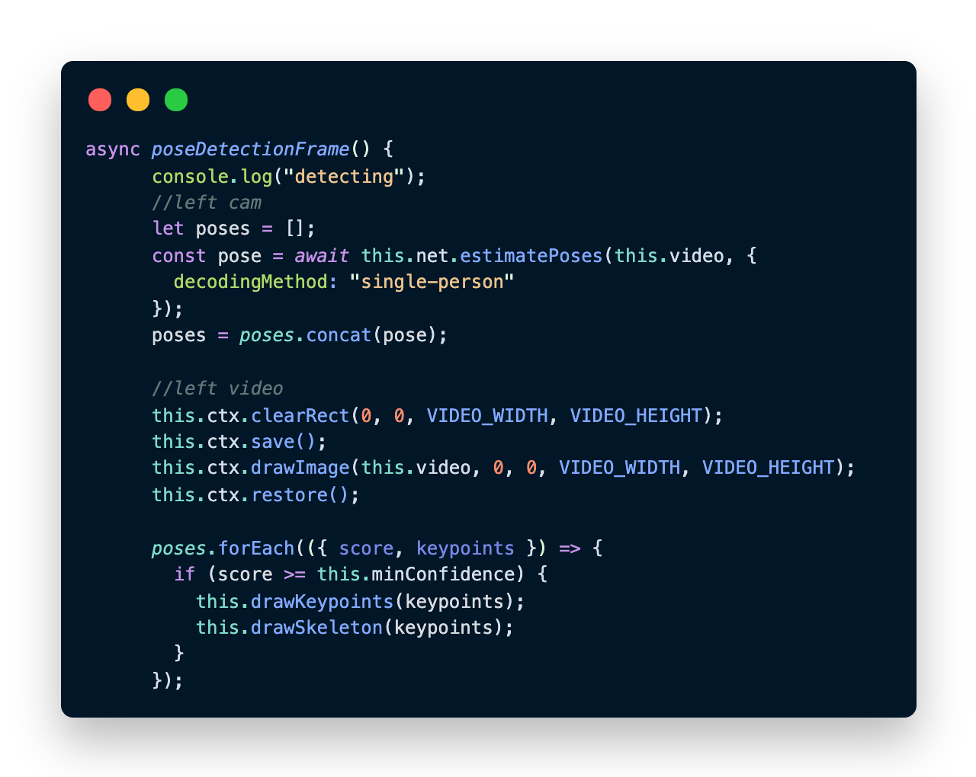
Posing
For each video, load a model and start estimating poses.
Append each pose to an array for future scoring
Draw keypoints and skeleton using estimated location of keypoint
Use “requestAnimationFrame” API to detect video keyframes

Slide 17
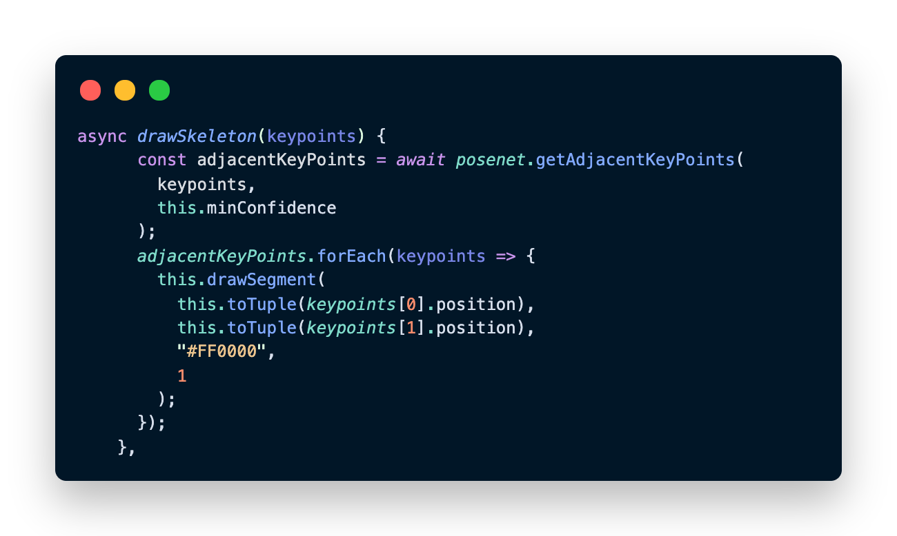
Drawing a skeleton 🦴
Gather adjacent keypoints and draw dots and lines using Canvas API
beginPath(), arc(), fill() for dots
beginPath(), moveTo(), lineTo(), stroke() for lines
You can tweak color and line width – this is DIY

Slide 18
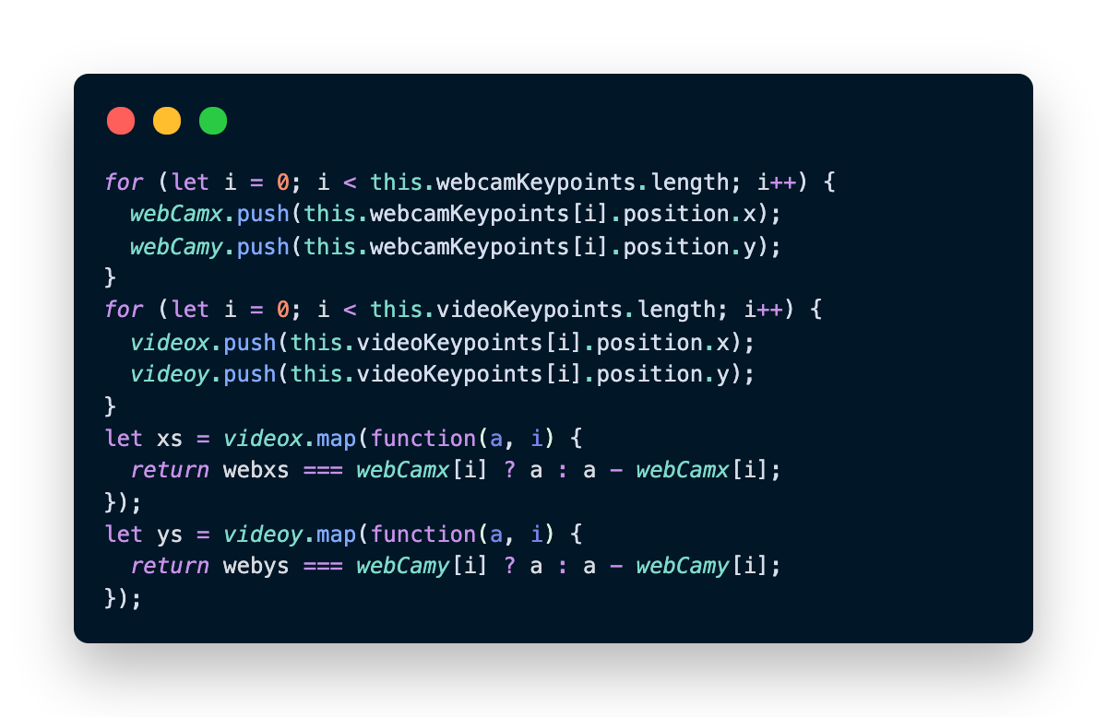
Scoring
Gather keypoints from webcam and video feed
Compare the webcam points array to the video points array
Find the difference between the webcam points and the video points
Your score will degrade to negative as you diverge from the video (fix this maybe?)

Slide 19
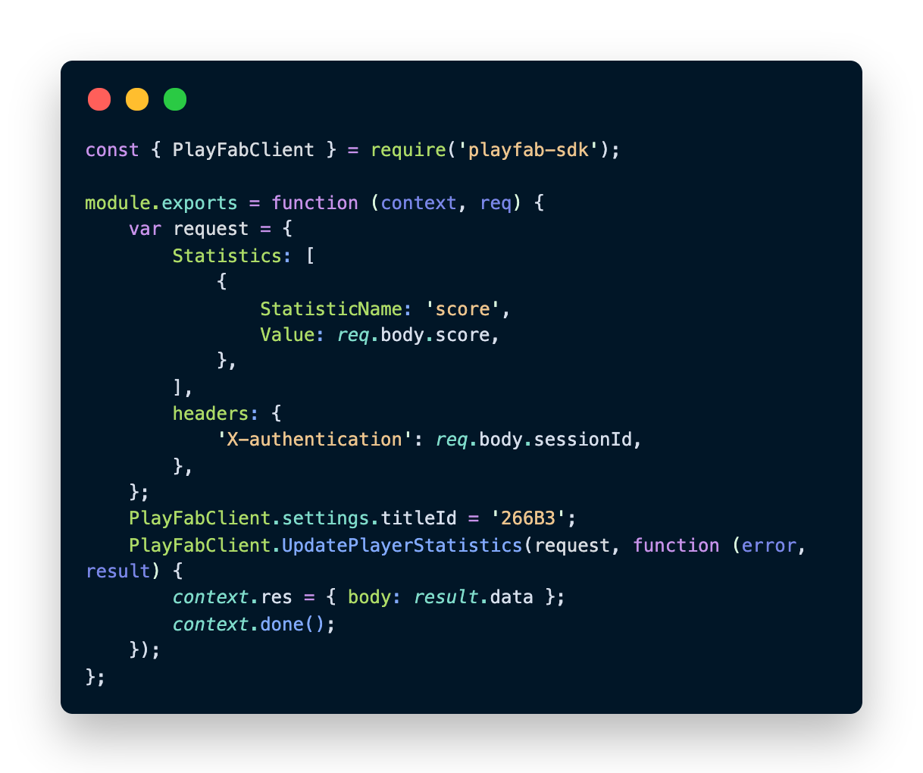
PlayFab Backend
Let’s use PlayFab as a Mobile PAAS backend service, great for games
Put all calls in /api folder
Use Azure Functions to call PlayFab

Slide 20
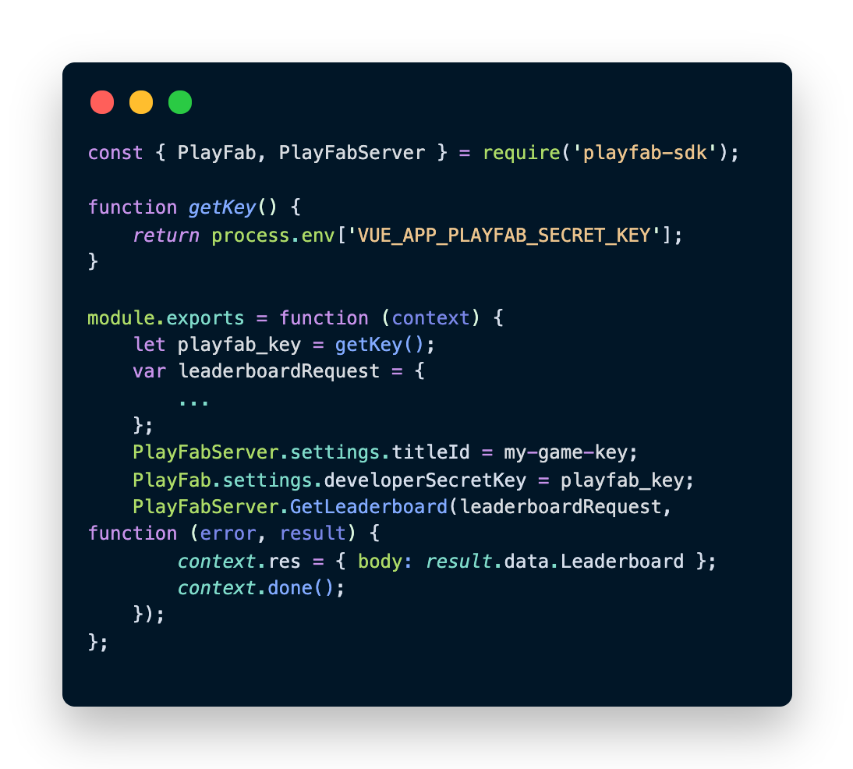
Leaderboard
PlayFab creates a public leaderboard of all players if they have an account
You need the title’s secret key, so save that in environment vars
Build leaderboard via PlayFab API, use axios to display it

Slide 21
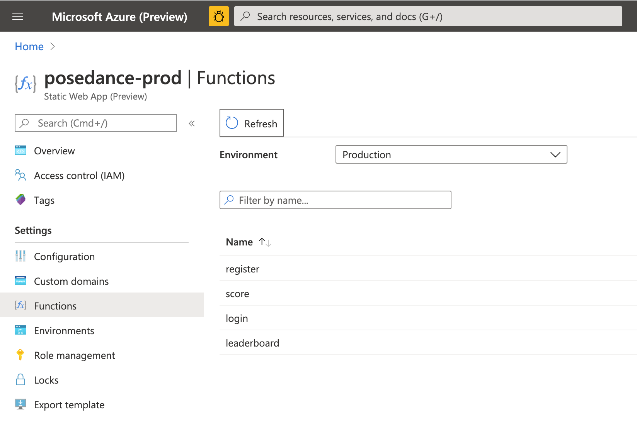
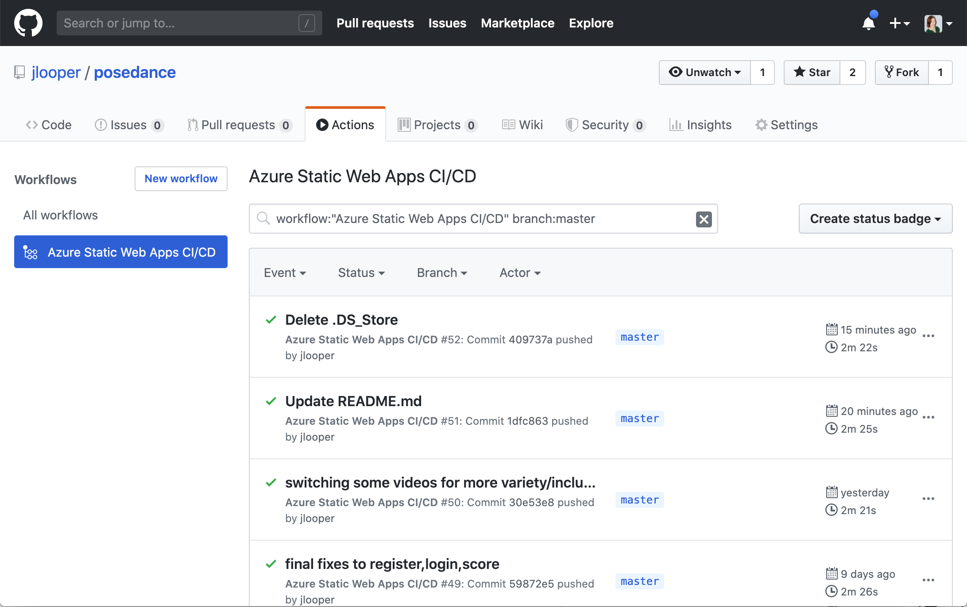
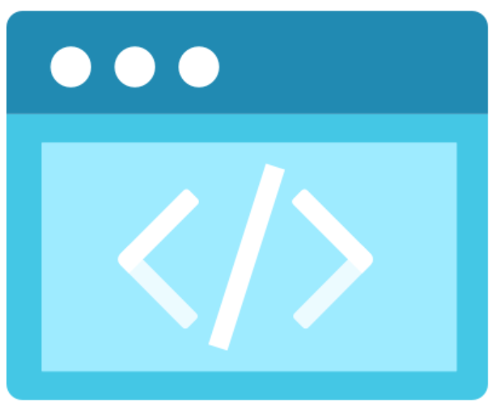
Deployment
Where will this app live?
New! HOT! Azure Static Web Apps!
Azure Static Web Apps FTW!
Store an environment variable in the app portal
Integrate Azure Functions
Quick and easy deployment with GitHub Actions
Works GREAT for Vue.js/ VuePress Static apps and SPAs!

Slide 22
Let’s dance!

